Slide 1


Getting Started with Ansible
Notes:
1

Slide 2





Topics for Today!
Ansible's Architecture
Declarative vs. Imperative Models
Ansible Components
Modules, Tasks, and Playbooks
Communication via SSH
Notes:
2

Slide 3
Ansible's Agentless Architecture
What does "Agentless" Mean?
  Agentless means you don't need to install or run any software (agents) on the systems you're managing.
Why Agentless Matters
No Agent Setup or Maintenance
Quicker Host Onboarding
Simpler & More Secure
Minimal Resource Use on Target Machines
Easier Troubleshooting
Notes:
3

Slide 4




How Ansible Works
Connect via SSH
Ansible uses secure SSH protocol to connect to managed nodes.
Copy Python Modules
Temporary Python modules are copied to the target system.
Execute Tasks
Tasks are executed on the managed node.
Clean Up
Temporary files are removed, leaving no footprint.
Notes:
4

Slide 5
Key Characteristics of Ansible
Agentless
Push-based
No software to install on nodes, reducing maintenance overhead.
Central node pushes configurations when needed.
YAML Playbooks
Idempotent
Simple, readable configuration files that are easy to understand.
Running playbooks repeatedly won't change results if system is already configured.
Notes:
5

Slide 6





Real-World Benefits of Agentless Architecture
Cloud Provisioning
Infrastructure Audits
Temporary Instances
Secure Environments
Cross-platform Deployment
Notes:
6

Slide 7




Declarative vs. Imperative Models
Imperative Model
Declarative Model
Focuses on what the final state should be.
Focuses on how to achieve the result.
  Desired end state description
  Step-by-step instructions
  State-aware
  Procedural execution
  Idempotent execution
  No automatic state checking
Notes:
7

Slide 8
Side-by-Side Comparison
Task
Imperative (Bash)
Declarative (Ansible)
Install nginx
sudo apt install nginx
apt:
name=nginx
state=present
Start nginx
sudo systemctl start nginx
service:
name=nginx
state=started
Enable service
sudo systemctl enable nginx
service:
enabled=yes
Notes:
8

Slide 9

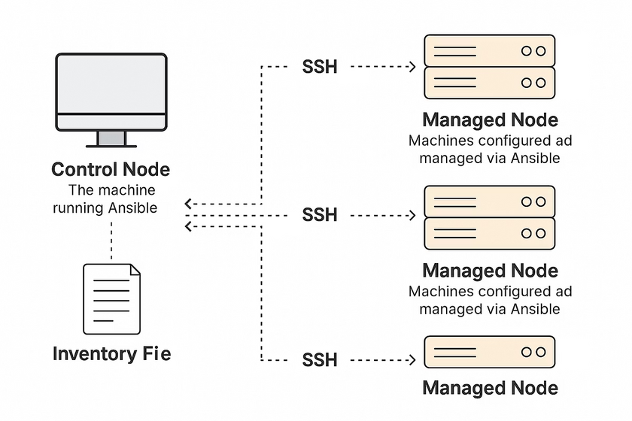



Ansible Components
The 3 main components of Ansible on which the entire configuration management in dependent on are:
Control/ Master Node
Managed Node
Inventory file
The machine where Ansible is installed.
The remote machines on which Ansible connects & configures.
The file that contains all the details of the connected groups (resources).
Ex: Web servers, database, load balancers, containers etc.
Notes:
9

Slide 10
Quick Summary
Component
What it does
Practical
Control node
Runs Ansible, holds playbooks
Needs Ansible & SSH access
Managed node
Gets configured
Must allow SSH and have Python
Inventory file
Tells Ansible about hosts
Can be flat INI or structured YAML
Notes:
10

Slide 11



Ansible File Components
Modules
Tasks
Playbooks
  Reusable code performing specific actions
  Single units of work calling modules with arguments.
  YAML files defining complete automation tasks.
  Ex: yum/apt, service, copy, file, user, ping, debug.
  Elements: name, hosts, become: true/false, tasks, apt & service.
- name: Install nginx
apt:
name: nginx
state: present
Notes:
11

Slide 12
Challenging Activity:
Let's analyze the YAML Snippets to better understand the file components of Ansible.
Instructions:
For each snippet, answer:
1
Which module is used?
2
What is the task doing?
3
Can it be part of a playbook?
(check for valid syntax/structure)
4
Is it idempotent?
(does it run the same way repeatedly without changing the system unnecessarily?)
Notes:
12

Slide 13
Snippet-1 & 2
- name: Upgrade all packages using shell
shell: apt update && apt upgrade -y
- name: Add a line to /etc/hosts
lineinfile:
path: /etc/hosts
line: "192.168.0.10 app.internal"
  Module used ?
  Task does ?
  Can be part of playbook ?
  Module used ?
  Is it idempotent ?
  Task does ?
  Can be part of playbook ?
  Is it idempotent ?
Notes:
13

Slide 14
Snippet-1 & 2
- name: Upgrade all packages using shell
shell: apt update && apt upgrade -y
- name: Add a line to /etc/hosts
lineinfile:
path: /etc/hosts
line: "192.168.0.10 app.internal"
Answers:
  Module used: shell
  Task does: Runs apt update and apt upgrade through the shell (unmanaged by Ansible)
Answers:
  Module used: lineinfile
  Can be part of playbook? Yes, syntactically valid
  Task does: Adds a specific line to /etc/hosts
  Is it idempotent? No — Every run could upgrade something (no state checks like the apt module would do)
  Can be part of playbook? Yes
  Is it idempotent? Yes — lineinfile ensures no duplicates are added
  Note: We can use APT/YUM instead of shell as module because shell is not checking or registering state like apt module would, hence its not idempotent. If we use apt/yum, then it would register the state and will be idempotent in nature.
Notes:
14

Slide 15
Snippet-3 & 4
- name: Create temporary file
command: mktemp /tmp/tempfile.XXXXXX
- name: Install Apache web server
yum:
name: "{{ apache_package }}"
state: installed
  Module used ?
  Task does ?
  Module used ?
  Can be part of playbook ?
  Task does ?
  Is it idempotent ?
  Can be part of playbook ?
  Is it idempotent ?
Notes:
15

Slide 16
Snippet-3 & 4
- name: Create temporary file
command: mktemp /tmp/tempfile.XXXXXX
- name: Install Apache web server
yum:
name: "{{ apache_package }}"
state: installed
Answers:
  Module used: command
Answers:
  Task does: Creates a temp file with random name
  Module used: yum
  Can be part of playbook? Yes
  Task does: Installs the Apache package
  Is it idempotent? No — Every run generates a different file
  Can be part of playbook? Depends — Only if the variable apache_package is defined elsewhere (like in vars)
  Is it idempotent? Yes — yum ensures the package is only installed if missing
Notes:
16

Slide 17

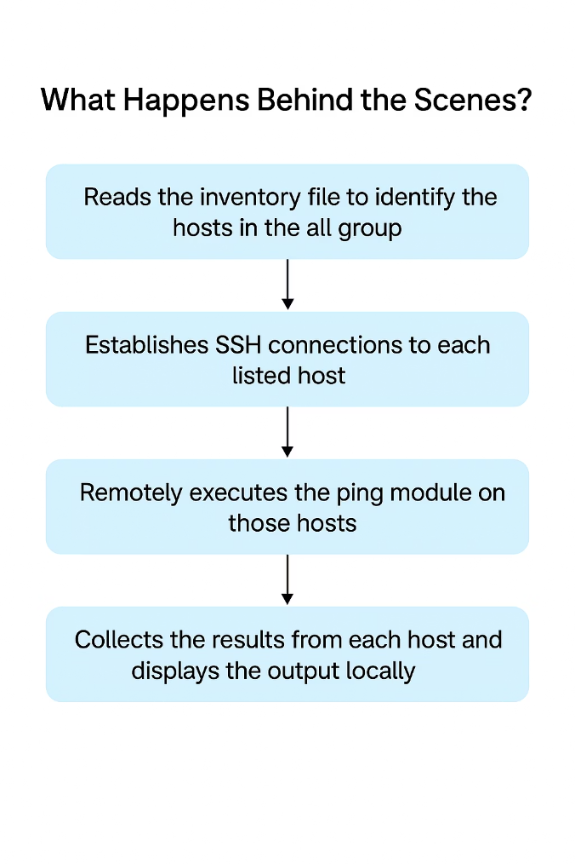
Communication via SSH
Ansible Uses SSH for Communication
Ansible connects to remote machines (known as managed nodes) from a control node (the system where Ansible is installed) using SSH.
  There is no need to install any agents on the managed nodes.
  All that’s required is Python and SSH access on those remote systems.
  Ansible executes modules (such as installing packages, copying files, restarting services) over the SSH channel.
When you run the command: ansible all -m ping
Notes:
17

Slide 18
Ansible Command Structure
Ad-hoc Ansible commands follow this pattern:
ansible <host_group> -i inventory -m <module_name> -a "<arguments>"
<host_group>
From your inventory file
-i inventory
Path to your inventory (if not using default)
-m
The module to run (e.g., ping, command, yum)
-a
Arguments passed to the module
Notes:
18

Slide 19
Useful Ad-hoc Commands
Check Connectivity (ping module)
Command: ansible all -i inventory.ini -m ping
What it does: Tests if Ansible can connect to all hosts using SSH.
Typical Output: Shows SUCCESS and ping: pong if the host is reachable.
Retrieve System Info (setup module)
Command: ansible all -i inventory.ini -m setup
What it does: Collects detailed system facts (OS, IPs, memory, etc.) from each host.
Why use it: Useful for using dynamic variables in playbooks.
Run a Shell Command (command module)
Commands:
ansible all -i inventory.ini -m command -a "uptime"
ansible all -i inventory.ini -m command -a "dpkg -l | grep nginx"
What it does: Runs a specific command on all hosts.
Note:
  Use command for simple commands (no shell features).
  Use the shell module if your command uses pipes (|), redirects, or variables.
Notes:
19

